Slide 1





Project #2:
Visualize Me, Captain!
Data Boot Camp
Lesson 18.1
© 2019 Trilogy Education Services, Inc.

Slide 2
Your Task
2

Slide 3
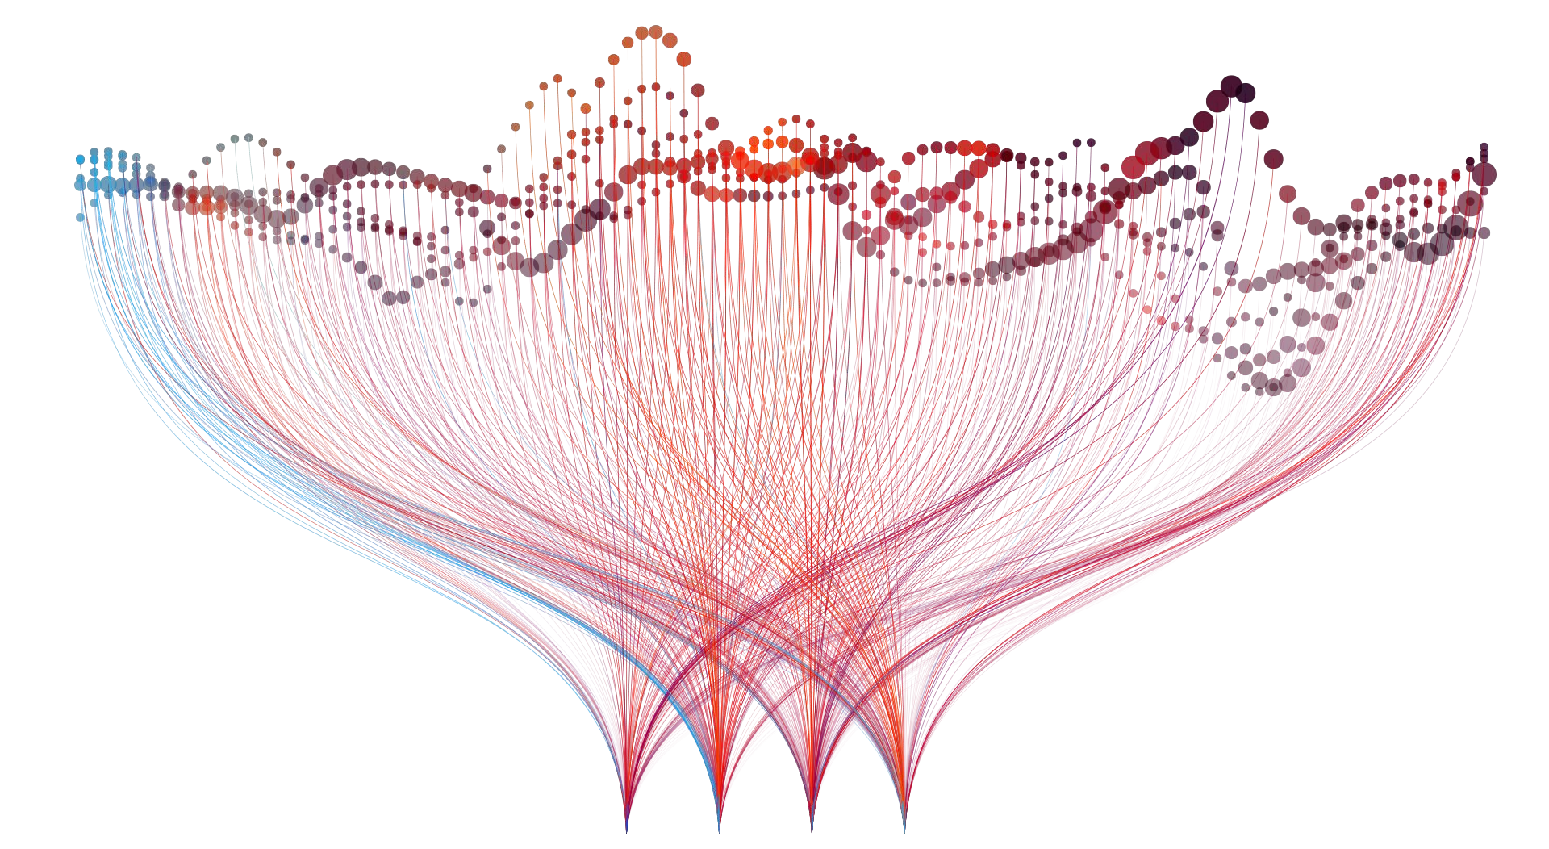
Tell a Story with Data

Slide 4

What?
4

Slide 5
Project Requirements

Slide 6
Project Description
01
02
03
04
05
Your task is to tell a story through data visualizations.
Focus on providing users an interactive means to explore data themselves.
Prepare a 10-minute presentation that lays out your theme, coding approach, data munging techniques, and ﬁnal visualization.
You may choose a project of any theme, but we encourage you to think broadly.
You will have ample time in class to work with your group, but expect to put in hours outside of class as well.

Slide 7
Speciﬁc Requirements
Your visualization must include a Python Flask–powered RESTful API, HTML/CSS, JavaScript, and at least one database (SQL, MongoDB, SQLite, etc.).
Your project should fall into one of the below four tracks:
A custom “creative” D3.js project (i.e., a nonstandard graph or chart)
A combination of web scraping and Leaﬂet or Plotly
A dashboard page with multiple charts that update from the same data
A “thick” server that performs multiple manipulations on data in a database prior to visualization (must be approved)
Your project should include at least one JS library that we did not cover.
Your project must be powered by a data set with at least 100 records.
Your project must include some level of user-driven interaction (e.g., menus, dropdowns, textboxes).
Your ﬁnal visualization should ideally include at least three views.

Slide 8
Schedule

Slide 9
Weekly Schedule
Day 1 (Today):
Between now and Saturday, you will need to start brainstorming topics with your group and researching potential data sets. Your focus should center around:
Selecting a topic
Finding a data set
Finding inspiration
“Sketching” your ideal visuals
Creating a 1-page proposal
Day 2:
You will need to create a 1-page proposal that includes:
A brief articulation of your chosen topic and rationale
A link to your data set(s) and a screenshot of the metadata if it exists.
3 or 4 screenshots of relevant, “inspiring” visualizations that frame your creative fodder
A sketch of the ﬁnal design
A link to the primary GitHub repository you’ll be housing your work in
Day 3: Project Work

Slide 10
Final Thoughts
01
02
03
Project week is a great time to tie up loose ends, both with your group and on your own.
If there are topics you’d like to review, shoot me and the TAs a message. We’re happy to do (recorded) extra review sessions for small groups during these weeks.
Good luck and have fun!

Slide 11

Questions?

